Slide 1
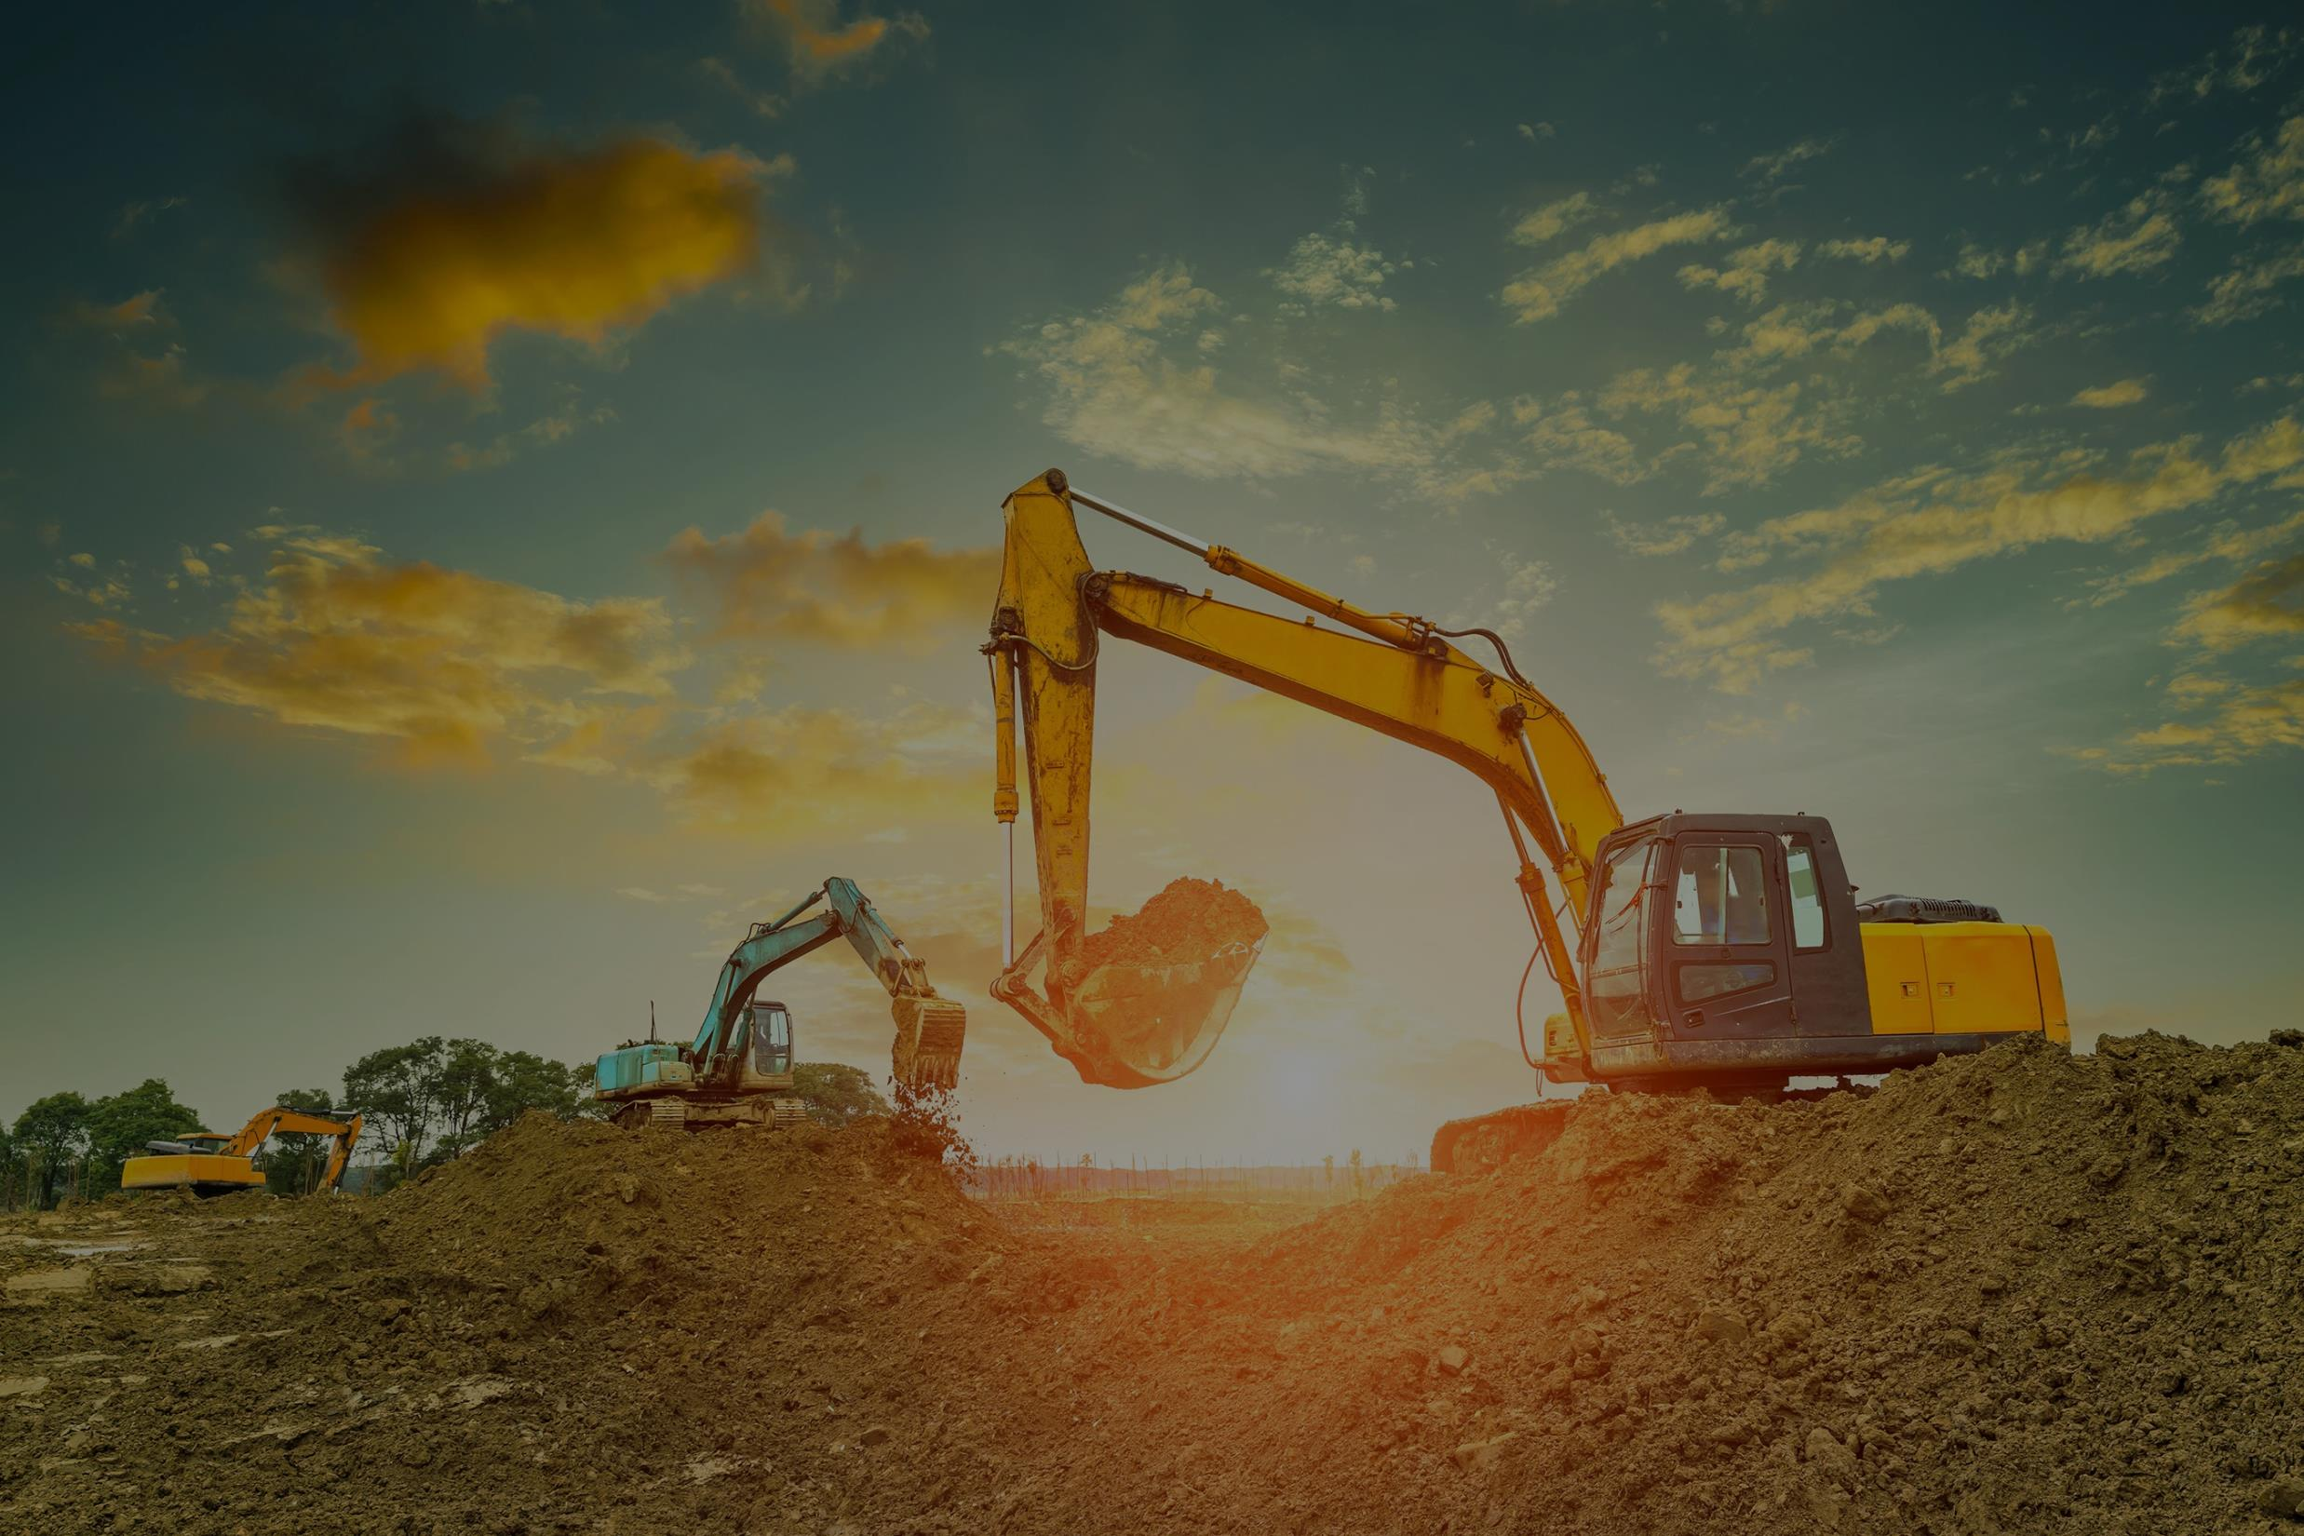
Romhas Construction
Name Romha Tekle ID 2017070067

Slide 2

Romhas Construction
About
Construction is the process of constructing a building or infrastructure. Construction differs from manufacturing in that manufacturing typically involves mass production of similar items without a designated purchaser, while construction typically takes place on location for a known client. Construction as an industry comprises six to nine percent of the gross domestic product of developed countries.

Slide 3
Romhas Construction
Construction starts with planning, design, and financing; it continues until the project is built and ready for use.
Large-scale construction requires collaboration across multiple disciplines.

Slide 4
Romhas Construction
Features
Home
About Us
Services
Portfolio
Contact Us

Slide 5
Romhas Construction
My website lets clients to meet best engineers online easily. This makes the construction process efficient.

